Slide 1

Gradient and Intercept
EQ : How are linear graphs, linear tables and linear rules similar?

Slide 2
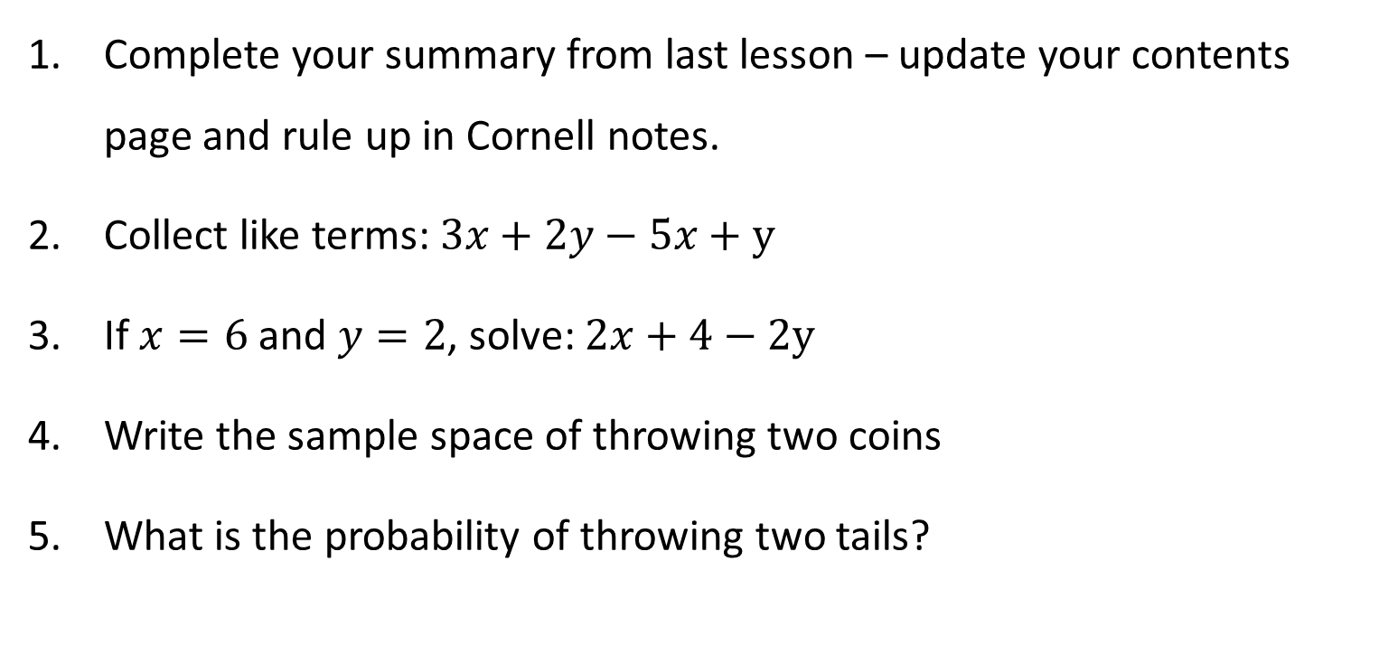
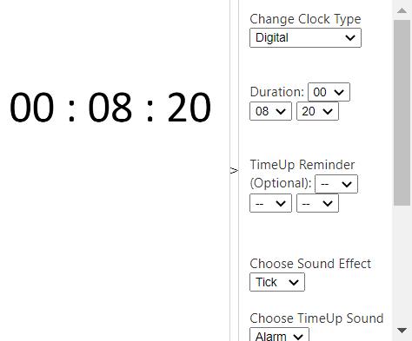
Topic: Gradient and Intercept EQ : How are linear graphs, linear tables and linear rules similar? LHS Questions
Get your VIVOS!
Complete your summary from last lesson – update your contents page and rule up in Cornell notes.
Collect like terms: $3x+2y−5x+y$
If $x=6$and $y=2$, solve: $2x+4−2y$
Write the sample space of throwing two coins
What is the probability of throwing two tails?

Slide 3
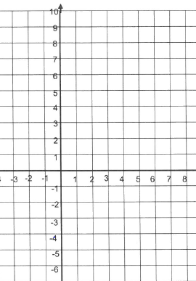
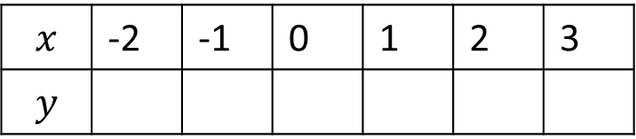




$$y$$
If we start with a rule
$$y=2x+1$$
We can create a table
$$y=2x+1$$
X
$$x$$ | -2 | -1 | 0 | 1 | 2 | 3
$$y$$
X
(-2,-3) (-1,-1) (0,1) (1,3) (2,5) (3,7)
X
X
From the table we can get coordinates and create a graph
$$x$$
X
X

Slide 4
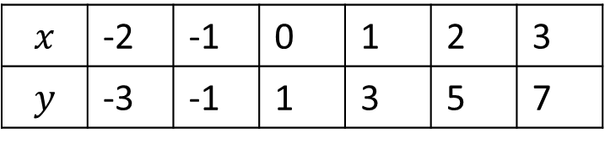

$$y$$
So our graph, our table and our rule are connected.
Each one can be used to find the gradient (M) and the y-intercept (C) for y=Mx+C
$$y=2x+1$$
$$y=2x+1$$
On our rule the gradient is the number in front of the variable.
How do we find it on our graph?
$$x$$ | -2 | -1 | 0 | 1 | 2 | 3
$$y$$ | -3 | -1 | 1 | 3 | 5 | 7
2
2
2
2
2
$$x$$
On our table the gradient is the amount y increases by each time

Slide 5
$$y$$
So our graph, our table and our rule are connected.
Each one can be used to find the gradient (M) and the y-intercept (C) for y=Mx+C
$$y=2x+1$$
$$y=2x+1$$
On our rule the y intercept is the number without a variable
On graph it is the number where our line “cuts” (intercepts) the y axis.
$$x$$ | -2 | -1 | 0 | 1 | 2 | 3
$$y$$ | -3 | -1 | 1 | 3 | 5 | 7
$$x$$
On our table the y intercept is y value when x is 0
On this graph, we can see the line “intercepts” the y axis at the value 1.
So our y intercept is the same for our table, graph and rule.

Slide 6
$$y$$
So our graph, our table and our rule are connected.
Each one can be used to find the gradient (M) and the y-intercept (C) for y=Mx+C
$$y=2x+1$$
$$y=2x+1$$
On our rule the gradient is the number in front of the variable.
Gradient = rise ÷ run
Rise is how far we “climb up” after the run. In this case we have risen 4 places.
$$x$$ | -2 | -1 | 0 | 1 | 2 | 3
$$y$$ | -3 | -1 | 1 | 3 | 5 | 7
2
2
2
2
2
$$x$$
On our table the gradient is the amount y increases by each time
Run is how far we travel along the ground. In this example we have “run” a distance of 2 places.
Gradient = rise ÷ run
= 4 ÷ 2
= 2
Which is the same value we had in the rule and the table

Slide 7
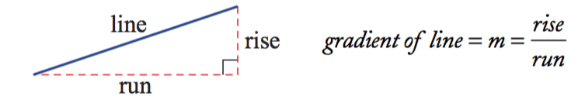
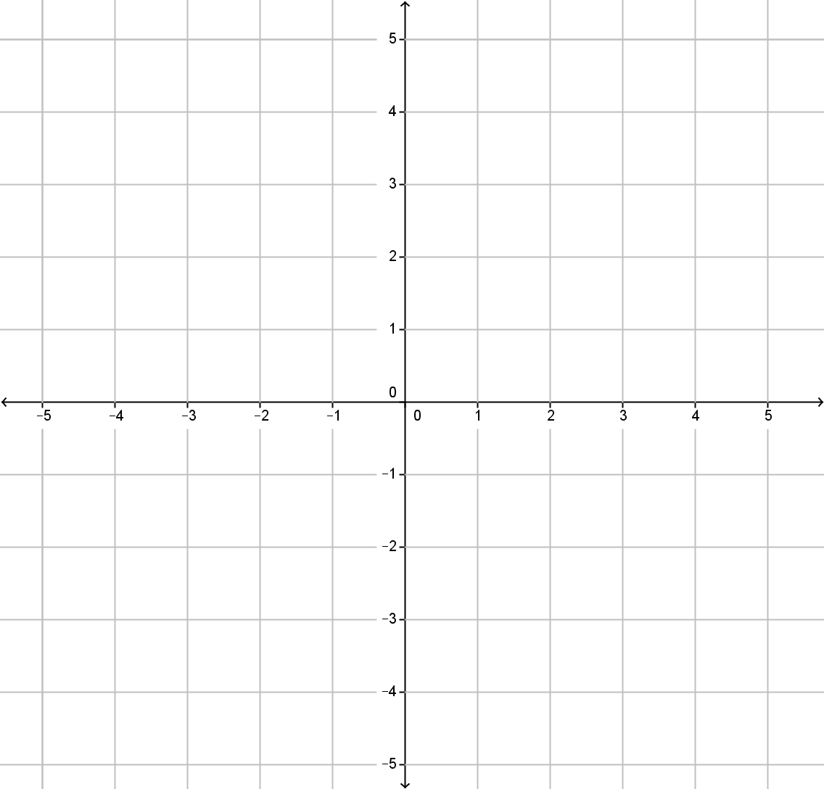
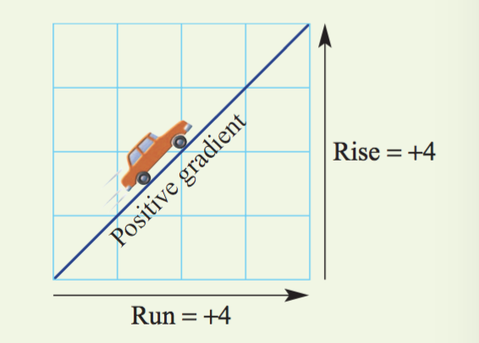
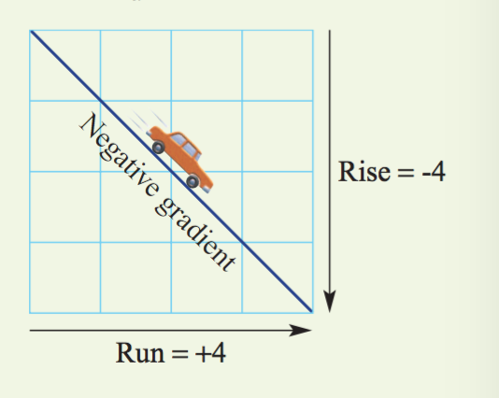
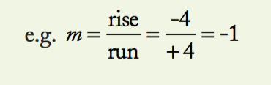
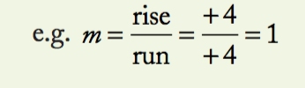

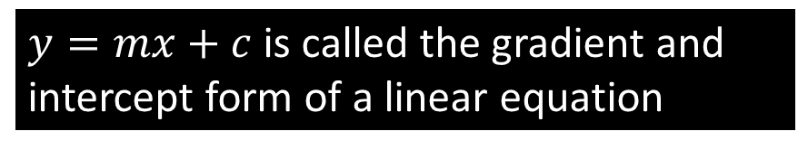


Topic: Gradient and Intercept
EQ : How are linear graphs, linear tables and linear rules similar
The gradient (m) is how steep the slope is.
The y-intercept (c) is where the graph meets the y axis.
$$gradient=rise ÷run.$$
$$y$$
A y-intercept of 2
$$x$$
A y-intercept of -3
$y=mx+c$is called the gradient and intercept form of a linear equation

Slide 8
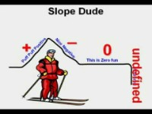
Slope Dude

Slide 9
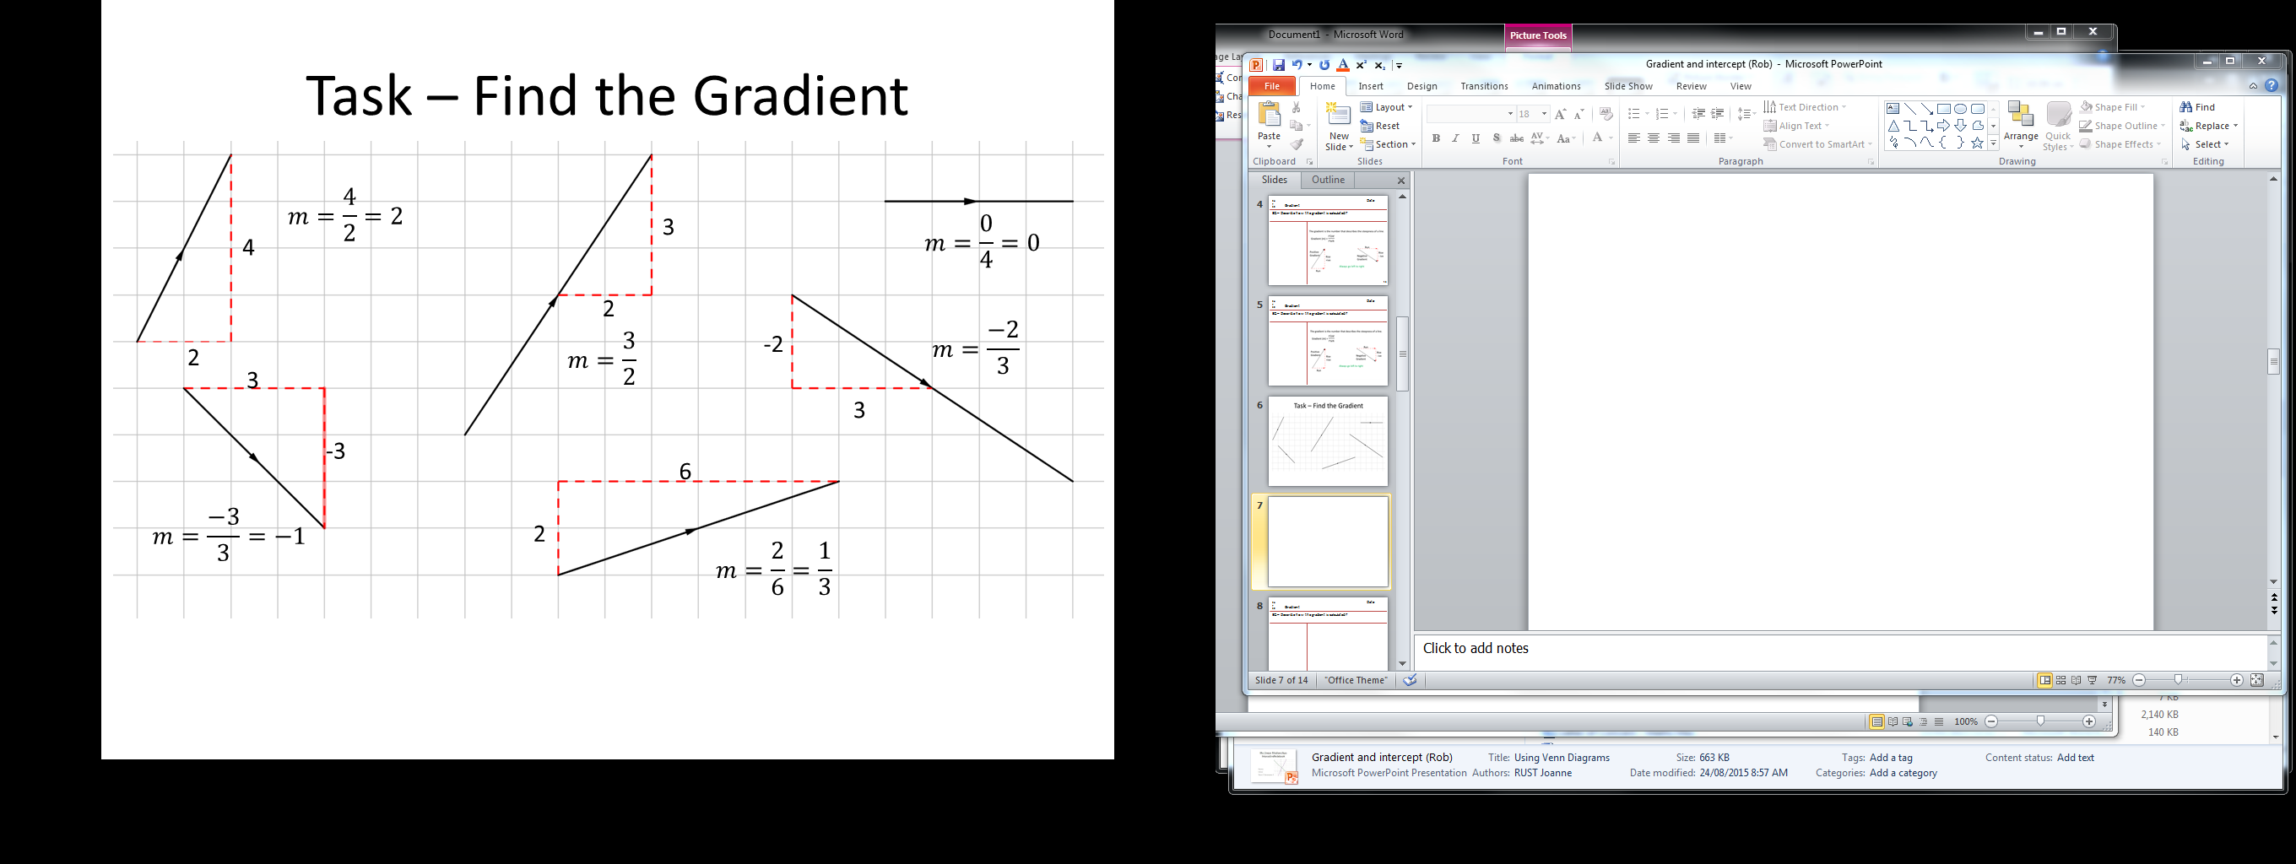
1
3
2
4
5
6

Slide 10




What is the y – intercept of these 4 lines?
$$y$$
$$y$$
A y-intercept of 4
A y-intercept of 1
A y-intercept of 0
$$x$$
$$x$$
A y-intercept of -3

Slide 11




Use the gradient and intercept to find the equation of these 3 lines
Use the gradient and intercept to draw these 3 rules
$$y$$
$$y$$
y = ______x + ______
y = 2x - 3
y = -x + 4
y = ______x + ______
y = 3x
$$x$$
$$x$$
y = ______x + ______

Slide 12
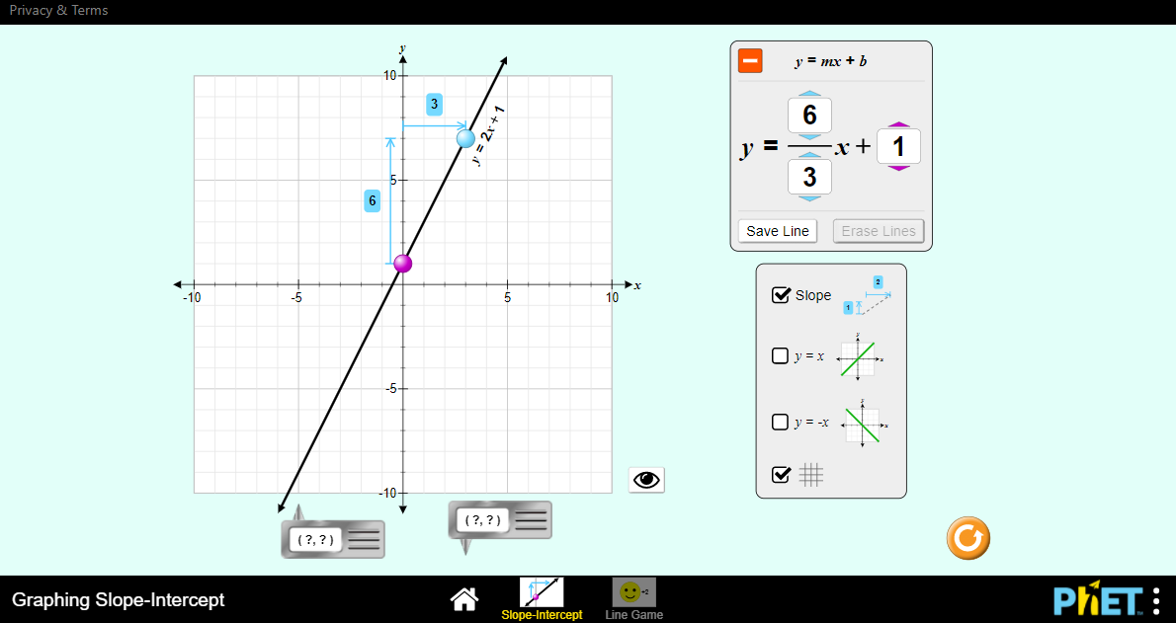

Slide 13
Complete the worksheet

